Slide 1
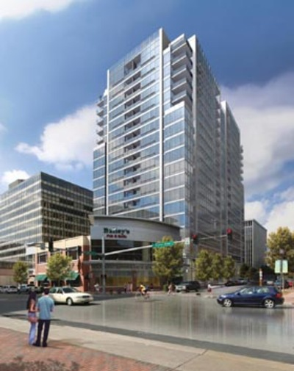

Christopher R. Stultz
CONSTRUCTION MANAGEMENT
2009 SENIOR THESIS PRESENTATION
THE PENNSYLVANIA STATE UNIVERSITY

Slide 2
Presentation Outline
Creating Sustainability in Crystal City
  Crystal Plaza II Overview
    Project background, challenges, site, and team
  Consolidation of Slab Penetrations
    Structural conditions, resolutions, recommendations
  Building Integrated Solar Energy System
    Design considerations, technology, energy results
  Peak Demand Shift and Demand Response Programs
    Background, local programs, generator use, results
  Financing Projects through Energy Savings
    Goals, incentives/rebates
  Conclusion and Questions

Slide 3
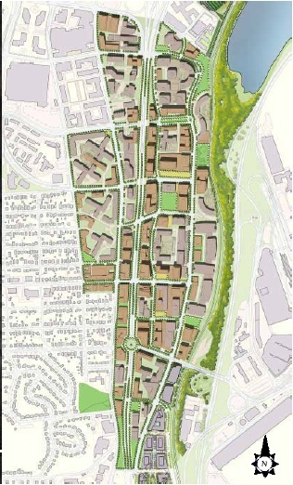
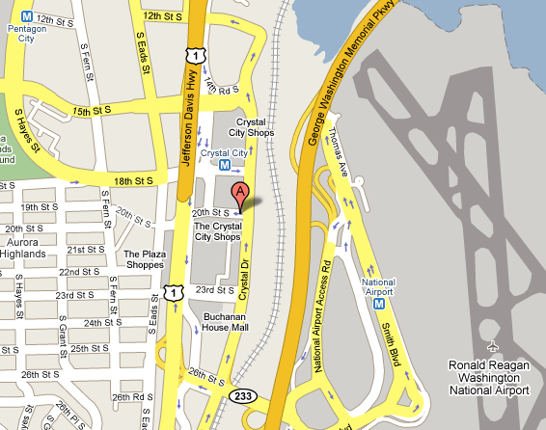
Crystal Plaza II Overview
Creating Sustainability in Crystal City
  Crystal Plaza II Overview
    Project background, challenges, site, and team
  Consolidation of Slab Penetrations
  Building Integrated Solar Energy System
  Peak Demand Shift and Demand Response Programs
  Financing Projects through Energy Savings
  Conclusion and Questions
Location
220 20th Street Arlington VA

Slide 4
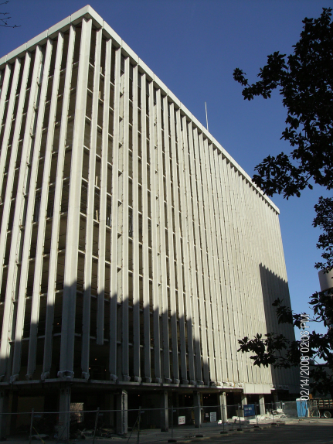
Crystal Plaza II Overview
Creating Sustainability in Crystal City
  Crystal Plaza II Overview
    Project background, challenges, site, and team
  Consolidation of Slab Penetrations
  Building Integrated Solar Energy System
  Peak Demand Shift and Demand Response Programs
  Financing Projects through Energy Savings
  Conclusion and Questions
Building History
  Originally 12 story office in commercial complex that featured similar designs and architecture
  Constructed in 1969 by Robert H Smith Group
  Now owned by Vornado/Charles E. Smith
  Originally to be demolished
  Renovation into266 unit apartment complex
  Increase from 12 to 20 stories
  Part of changing Crystal City
Location
220 20th Street Arlington VA

Slide 5
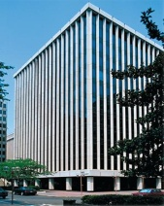
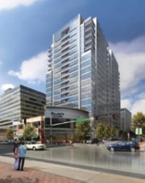
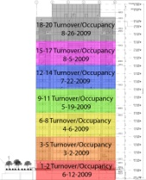
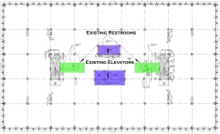
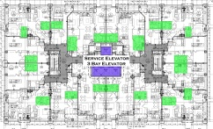
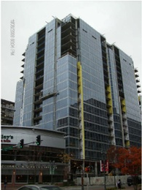
Crystal Plaza II Overview
Constructability Challenges
Renovation
Required Delivery
Reconfiguration
Residential Curtain Wall
Creating Sustainability in Crystal City
  Crystal Plaza II Overview
    Project background, challenges, site, and team
  Consolidation of Slab Penetrations
  Building Integrated Solar Energy System
  Peak Demand Shift and Demand Response Programs
  Financing Projects through Energy Savings
  Conclusion and Questions

Slide 6


Crystal Plaza II Overview
Constructability Challenges
Renovation
Required Delivery
Reconfiguration
Residential Curtain Wall
Creating Sustainability in Crystal City
  Crystal Plaza II Overview
    Project background, challenges, site, and team
  Consolidation of Slab Penetrations
  Building Integrated Solar Energy System
  Peak Demand Shift and Demand Response Programs
  Financing Projects through Energy Savings
  Conclusion and Questions
Renovation
  40 year old structure
    Deficiencies
  Unforeseen Conditions

Slide 7

Crystal Plaza II Overview
Constructability Challenges
Renovation
Required Delivery
Reconfiguration
Residential Curtain Wall
Creating Sustainability in Crystal City
  Crystal Plaza II Overview
    Project background, challenges, site, and team
  Consolidation of Slab Penetrations
  Building Integrated Solar Energy System
  Peak Demand Shift and Demand Response Programs
  Financing Projects through Energy Savings
  Conclusion and Questions
Required Delivery
  Multi phase delivery
  Multiple inspections
  Life Safety equipment

Slide 8
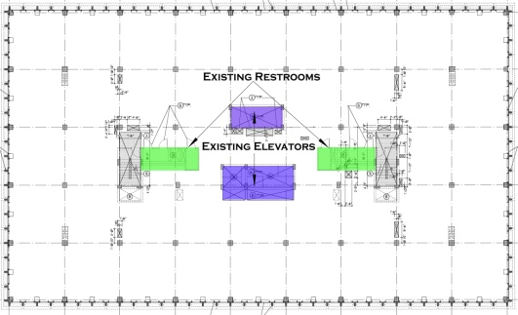
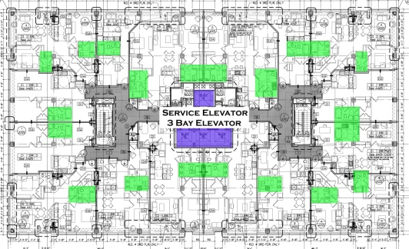
Crystal Plaza II Overview
Constructability Challenges
Renovation
Required Delivery
Reconfiguration
Residential Curtain Wall
Creating Sustainability in Crystal City
  Crystal Plaza II Overview
    Project background, challenges, site, and team
  Consolidation of Slab Penetrations
  Building Integrated Solar Energy System
  Peak Demand Shift and Demand Response Programs
  Financing Projects through Energy Savings
  Conclusion and Questions
Reconfiguration
  More decentralized
  More slab penetrations
  Structural Integrity

Slide 9
Crystal Plaza II Overview
Constructability Challenges
Renovation
Required Delivery
Reconfiguration
Residential Curtain Wall
Creating Sustainability in Crystal City
  Crystal Plaza II Overview
    Project background, challenges, site, and team
  Consolidation of Slab Penetrations
  Building Integrated Solar Energy System
  Peak Demand Shift and Demand Response Programs
  Financing Projects through Energy Savings
  Conclusion and Questions
Residential Curtain Wall
  Weather proofing
  Mechanical systems
  Lead time

Slide 10
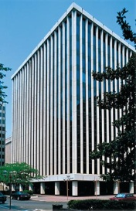

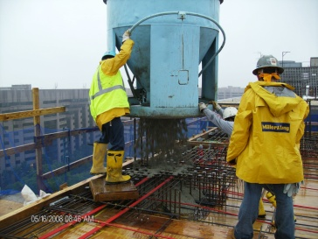

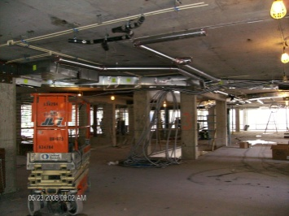
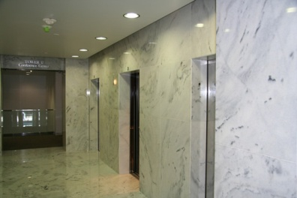
Crystal Plaza II Overview
Creating Sustainability in Crystal City
  Crystal Plaza II Overview
    Project background, challenges, site, and team
  Consolidation of Slab Penetrations
  Building Integrated Solar Energy System
  Peak Demand Shift and Demand Response Programs
  Financing Projects through Energy Savings
  Conclusion and Questions
Schedule
  Construction Critical Path
    Demolition
    Concrete Structure
    Façade/Dry-in
    MEP Fit Out
    Lobby Finishes
Important Dates
  Review/Issue Building Permit
    March 15,2007
  FAA Approval
    May 18, 2007
  Substantial Completion
    August 31, 2009

Slide 11
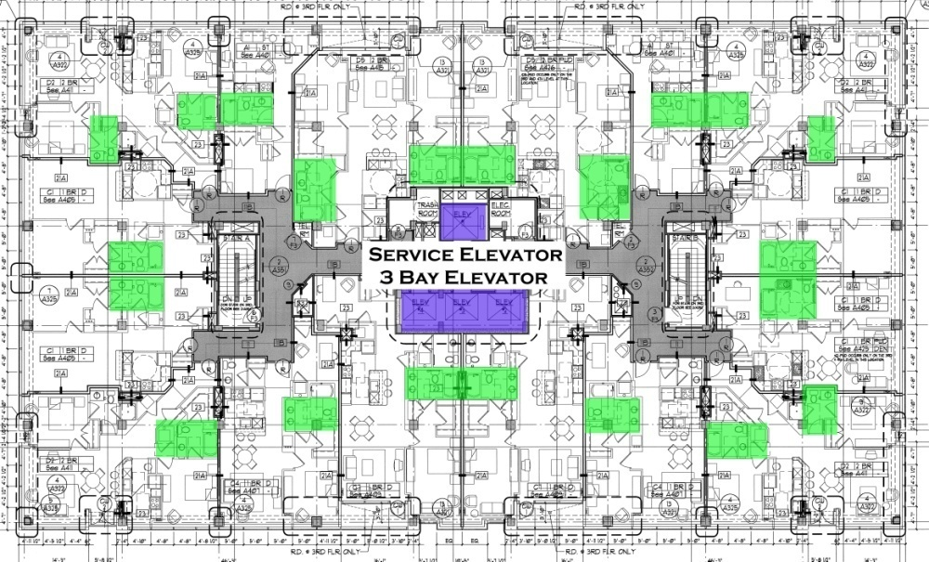
Consolidation of Slab Penetrations
Creating Sustainability in Crystal City
  Crystal Plaza II Overview
  Consolidation of Slab Penetrations
    Structural conditions, resolutions, recommendations
  Building Integrated Solar Energy System
  Peak Demand Shift and Demand Response Programs
  Financing Projects through Energy Savings
  Conclusion and Questions
Background
  Change in use, commercial to residential
  Increased slab penetrations through existing slab
  Coordination
  Large Risk
Problem Statement
  Constructability
  Schedule
  Cost
  Structural Integrity
Goal
  Locate marginal and problematic areas to provide better information to the GC and MEP designers to mitigate risk.

Slide 12
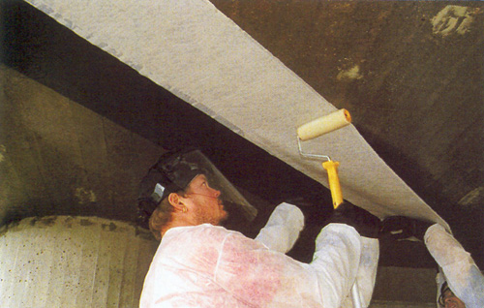
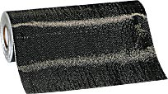
Consolidation of Slab Penetrations
Creating Sustainability in Crystal City
  Crystal Plaza II Overview
  Consolidation of Slab Penetrations
    Structural conditions, resolutions, recommendations
  Building Integrated Solar Energy System
  Peak Demand Shift and Demand Response Programs
  Financing Projects through Energy Savings
  Conclusion and Questions
Research
  Each bathroom has 3-9 penetrations, often 6-12 in group
  GPR ineffective
  Reinforcement
    Carbon Fiber Reinforced Polymer (CFRP)
    Large strength gains, minimal stiffness
Problem Statement
  Constructability
  Schedule
  Cost
  Structural Integrity
Goal
  Locate marginal and problematic areas to provide better information to the GC and MEP designers to mitigate risk.

Slide 13
Consolidation of Slab Penetrations
Creating Sustainability in Crystal City
  Crystal Plaza II Overview
  Consolidation of Slab Penetrations
    Structural conditions, resolutions, recommendations
  Building Integrated Solar Energy System
  Peak Demand Shift and Demand Response Programs
  Financing Projects through Energy Savings
  Conclusion and Questions
Research
  Each bathroom has 3-9 penetrations, often 6-12 in group
  GPR ineffective
  Reinforcement
    Carbon Fiber Reinforced Polymer (CFRP)
    Large strength gains, minimal stiffness
Constructability
  Do first, check second
  Rework
  Coordination

Slide 14
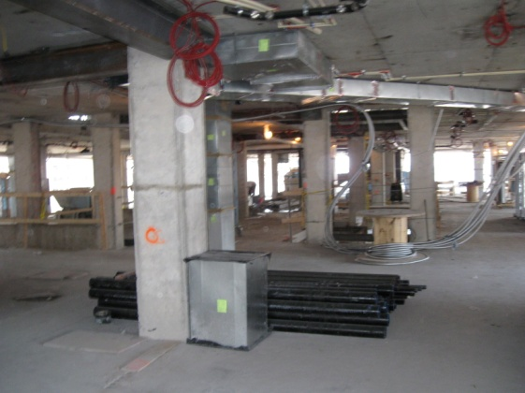
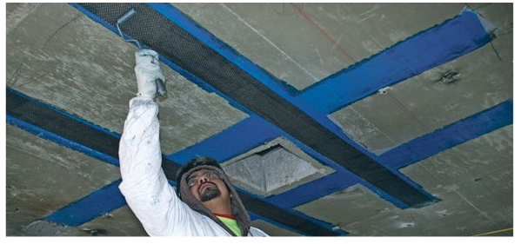
Consolidation of Slab Penetrations
Creating Sustainability in Crystal City
  Crystal Plaza II Overview
  Consolidation of Slab Penetrations
    Structural conditions, resolutions, recommendations
  Building Integrated Solar Energy System
  Peak Demand Shift and Demand Response Programs
  Financing Projects through Energy Savings
  Conclusion and Questions
Schedule
  Rough in of MEP and framing complete
  CFRP
    requires large lay down area
    Takes 2-7 days to install
  About a 3 week delay by process
  Fireproofing
    Overlooked
    Postponed inspections
    Rework of installed drywall
    Delayed drywall 2 weeks
Cost
  CFRP
    ~$50/sf, 840 sf, $42,000
  Survey
    $30,000
  GC Review of penetrations
    $8,000
  Fireproofing
    $21,000
    Rework $25,000
  Over $120,000 for CFRP process

Slide 15
Consolidation of Slab Penetrations
Creating Sustainability in Crystal City
  Crystal Plaza II Overview
  Consolidation of Slab Penetrations
    Structural conditions, resolutions, recommendations
  Building Integrated Solar Energy System
  Peak Demand Shift and Demand Response Programs
  Financing Projects through Energy Savings
  Conclusion and Questions
Preconstruction Structural Analysis
    Look at single frame
    Could be extended to entire slab
    Uses direct design method to determine reinforcement requirements

Slide 16
Consolidation of Slab Penetrations
Creating Sustainability in Crystal City
  Crystal Plaza II Overview
  Consolidation of Slab Penetrations
    Structural conditions, resolutions, recommendations
  Building Integrated Solar Energy System
  Peak Demand Shift and Demand Response Programs
  Financing Projects through Energy Savings
  Conclusion and Questions
Existing Use
    100 psf live load
    20’ x 20’ bays
    20” x 20” columns
    10” slab
    5000 psi concrete (125 psf dl)
    #4 rebar

Slide 17
Consolidation of Slab Penetrations
Creating Sustainability in Crystal City
  Crystal Plaza II Overview
  Consolidation of Slab Penetrations
    Structural conditions, resolutions, recommendations
  Building Integrated Solar Energy System
  Peak Demand Shift and Demand Response Programs
  Financing Projects through Energy Savings
  Conclusion and Questions
Existing Use
    100 psf live load
    20’ x 20’ bays
    20” x 20” columns
    10” slab
    5000 psi concrete (125 psf dl)
    #4 rebar
Frame | Total Width (ft) | CS (ft) | MS (ft) | Total - Mom | CS (-M) | MS (-M) | Total + Mom | CS (+M) | MS (+M)
A | 20 | 10 | 10 | -182.34 | -136.76 | -45.59 | 135.45 | 81.27 | 54.18
B | 10 | 5 | 5 | -33.86 | -33.86 | 0.00 | 67.73 | 40.64 | 27.09
 |  |  |  | -91.17 | -68.38 | -22.79
C | 20 | 10 | 10 | -182.34 | -136.76 | -45.59 | 135.45 | 81.27 | 54.18
D | 10 | 5 | 5 | -33.86 | -33.86 | 0.00 | 67.73 | 40.64 | 27.09
 |  |  |  | -91.17 | -68.38 | -22.79

Slide 18
Consolidation of Slab Penetrations
For Frame A Design Reinforcement For CS (Will Use #4 Bars)
Item | Description | Span
 |  | M⁻ | M⁺
1 | M_{u} (ft-Kip) | -136.76 | 81.27
2 | b (in) | 100 | 100
3 | d( in) | 7.975 | 7.975
4 | M_{n} = M_{u}/0.9 (ft-Kip) | -151.95 | 90.30185
5 | R = M_{n}/bd² | 286.6957 | 170.3792
6 | ρ [Table A.5a] | 0.005 | 0.0028
7 | Ast = ρbd (in²) | 3.9875 | 2.233
8 | A_{st,min} = 0.002bt | 2 | 2
9 | N = #7 or #8 (Greater)/Abar | 19.9375 | 11.165
10 | Nmin = width_{strip}/2t | 6 | 6
* # Bars used is greater value of 9 or 10
For Frame A Design Reinforcement For MS (Will Use #4 Bars)
Item | Description | Span
 |  | M⁻ | M⁺
1 | M_{u} (ft-Kip) | -45.59 | 54.18
2 | b (in) | 100 | 100
3 | d( in) | 7.975 | 7.975
4 | M_{n} = M_{u}/0.9 (ft-Kip) | -50.6501 | 60.20123
5 | R = M_{n}/bd² | 95.56524 | 113.5861
6 | ρ [Table A.5a] | 0.0016 | 0.0019
7 | Ast = ρbd (in²) | 1.276 | 1.51525
8 | A_{st,min} = 0.002bt | 2 | 2
9 | N = #7 or #8 (Greater)/Abar | 6.38 | 7.57625
10 | Nmin = width_{strip}/2t | 6 | 6
* # Bars used is greater value of 9 or 10
Frame | Total Width (ft) | CS (ft) | MS (ft) | Total - Mom | CS (-M) | MS (-M) | Total + Mom | CS (+M) | MS (+M)
A | 20 | 10 | 10 | -182.34 | -136.76 | -45.59 | 135.45 | 81.27 | 54.18
B | 10 | 5 | 5 | -33.86 | -33.86 | 0.00 | 67.73 | 40.64 | 27.09
 |  |  |  | -91.17 | -68.38 | -22.79
C | 20 | 10 | 10 | -182.34 | -136.76 | -45.59 | 135.45 | 81.27 | 54.18
D | 10 | 5 | 5 | -33.86 | -33.86 | 0.00 | 67.73 | 40.64 | 27.09
 |  |  |  | -91.17 | -68.38 | -22.79
Creating Sustainability in Crystal City
  Crystal Plaza II Overview
  Consolidation of Slab Penetrations
    Structural conditions, resolutions, recommendations
  Building Integrated Solar Energy System
  Peak Demand Shift and Demand Response Programs
  Financing Projects through Energy Savings
  Conclusion and Questions

Slide 19
Consolidation of Slab Penetrations
For Frame A Design Reinforcement For CS (Will Use #4 Bars)
Item | Description | Span
 |  | M⁻ | M⁺
1 | M_{u} (ft-Kip) | -136.76 | 81.27
2 | b (in) | 100 | 100
3 | d( in) | 7.975 | 7.975
4 | M_{n} = M_{u}/0.9 (ft-Kip) | -151.95 | 90.30185
5 | R = M_{n}/bd² | 286.6957 | 170.3792
6 | ρ [Table A.5a] | 0.005 | 0.0028
7 | Ast = ρbd (in²) | 3.9875 | 2.233
8 | A_{st,min} = 0.002bt | 2 | 2
9 | N = #7 or #8 (Greater)/Abar | 19.9375 | 11.165
10 | Nmin = width_{strip}/2t | 6 | 6
* # Bars used is greater value of 9 or 10
For Frame A Design Reinforcement For MS (Will Use #4 Bars)
Item | Description | Span
 |  | M⁻ | M⁺
1 | M_{u} (ft-Kip) | -45.59 | 54.18
2 | b (in) | 100 | 100
3 | d( in) | 7.975 | 7.975
4 | M_{n} = M_{u}/0.9 (ft-Kip) | -50.6501 | 60.20123
5 | R = M_{n}/bd² | 95.56524 | 113.5861
6 | ρ [Table A.5a] | 0.0016 | 0.0019
7 | Ast = ρbd (in²) | 1.276 | 1.51525
8 | A_{st,min} = 0.002bt | 2 | 2
9 | N = #7 or #8 (Greater)/Abar | 6.38 | 7.57625
10 | Nmin = width_{strip}/2t | 6 | 6
* # Bars used is greater value of 9 or 10
Creating Sustainability in Crystal City
  Crystal Plaza II Overview
  Consolidation of Slab Penetrations
    Structural conditions, resolutions, recommendations
  Building Integrated Solar Energy System
  Peak Demand Shift and Demand Response Programs
  Financing Projects through Energy Savings
  Conclusion and Questions

Slide 20
Consolidation of Slab Penetrations
Creating Sustainability in Crystal City
  Crystal Plaza II Overview
  Consolidation of Slab Penetrations
    Structural conditions, resolutions, recommendations
  Building Integrated Solar Energy System
  Peak Demand Shift and Demand Response Programs
  Financing Projects through Energy Savings
  Conclusion and Questions
New Use
    40 psf live load, 10 psf dead load
    20’ x 20’ bays
    20” x 20” columns
    10” slab
    5000 psi concrete (125 psf dl)
    #4 rebar

Slide 21
Consolidation of Slab Penetrations
Creating Sustainability in Crystal City
  Crystal Plaza II Overview
  Consolidation of Slab Penetrations
    Structural conditions, resolutions, recommendations
  Building Integrated Solar Energy System
  Peak Demand Shift and Demand Response Programs
  Financing Projects through Energy Savings
  Conclusion and Questions
New Use
    40 psf live load, 10 psf dead load
    20’ x 20’ bays
    20” x 20” columns
    10” slab
    5000 psi concrete (125 psf dl)
    #4 rebar
Frame | Total Width (ft) | CS (ft) | MS (ft) | Total - Moment | CS (-M) | MS (-M) | Total + Moment | CS (+M) | MS (+M)
A | 20 | 10 | 10 | -132.93 | -99.70 | -33.23 | 98.75 | 59.25 | 39.50
B | 10 | 5 | 5 | -24.69 | -24.69 | 0.00 | 49.37 | 29.62 | 19.75
 |  |  |  | -66.47 | -49.85 | -16.62
C | 20 | 10 | 10 | -132.93 | -99.70 | -33.23 | 98.75 | 59.25 | 39.50
D | 10 | 5 | 5 | -24.69 | -24.69 | 0.00 | 49.37 | 29.62 | 19.75
 |  |  |  | -66.47 | -49.85 | -16.62

Slide 22
Consolidation of Slab Penetrations
For Frame A Design Reinforcement For CS (Will Use #4 Bars)
Item | Description | Span
 |  | M⁻ | M⁺
1 | M_{u} (ft-Kip) | -99.70 | 59.25
2 | b (in) | 100 | 100
3 | d( in) | 7.975 | 7.975
4 | M_{n} = M_{u}/0.9 (ft-Kip) | -110.777 | 65.83296
5 | R = M_{n}/bd² | 209.0104 | 124.2119
6 | ρ [Table A.5a] | 0.0036 | 0.0021
7 | Ast = ρbd (in²) | 2.871 | 1.67475
8 | A_{st,min} = 0.002bt | 2 | 2
9 | N = #7 or #8 (Greater)/Abar | 14.355 | 8.37375
10 | Nmin = width_{strip}/2t | 6 | 6
* # Bars used is greater value of 9 or 10
For Frame A Design Reinforcement For MS (Will Use #4 Bars)
Item | Description | Span
 |  | M⁻ | M⁺
1 | M_{u} (ft-Kip) | -33.23 | 39.50
2 | b (in) | 100 | 100
3 | d( in) | 7.975 | 7.975
4 | M_{n} = M_{u}/0.9 (ft-Kip) | -36.9255 | 43.88864
5 | R = M_{n}/bd² | 69.67015 | 82.80794
6 | ρ [Table A.5a] | 0.0012 | 0.0014
7 | Ast = ρbd (in²) | 0.957 | 1.1165
8 | A_{st,min} = 0.002bt | 2 | 2
9 | N = #7 or #8 (Greater)/Abar | 4.785 | 5.5825
10 | Nmin = width_{strip}/2t | 6 | 6
* # Bars used is greater value of 9 or 10
Frame | Total Width (ft) | CS (ft) | MS (ft) | Total - Moment | CS (-M) | MS (-M) | Total + Moment | CS (+M) | MS (+M)
A | 20 | 10 | 10 | -132.93 | -99.70 | -33.23 | 98.75 | 59.25 | 39.50
B | 10 | 5 | 5 | -24.69 | -24.69 | 0.00 | 49.37 | 29.62 | 19.75
 |  |  |  | -66.47 | -49.85 | -16.62
C | 20 | 10 | 10 | -132.93 | -99.70 | -33.23 | 98.75 | 59.25 | 39.50
D | 10 | 5 | 5 | -24.69 | -24.69 | 0.00 | 49.37 | 29.62 | 19.75
 |  |  |  | -66.47 | -49.85 | -16.62
Creating Sustainability in Crystal City
  Crystal Plaza II Overview
  Consolidation of Slab Penetrations
    Structural conditions, resolutions, recommendations
  Building Integrated Solar Energy System
  Peak Demand Shift and Demand Response Programs
  Financing Projects through Energy Savings
  Conclusion and Questions

Slide 23
Consolidation of Slab Penetrations
For Frame A Design Reinforcement For CS (Will Use #4 Bars)
Item | Description | Span
 |  | M⁻ | M⁺
1 | M_{u} (ft-Kip) | -99.70 | 59.25
2 | b (in) | 100 | 100
3 | d( in) | 7.975 | 7.975
4 | M_{n} = M_{u}/0.9 (ft-Kip) | -110.777 | 65.83296
5 | R = M_{n}/bd² | 209.0104 | 124.2119
6 | ρ [Table A.5a] | 0.0036 | 0.0021
7 | Ast = ρbd (in²) | 2.871 | 1.67475
8 | A_{st,min} = 0.002bt | 2 | 2
9 | N = #7 or #8 (Greater)/Abar | 14.355 | 8.37375
10 | Nmin = width_{strip}/2t | 6 | 6
* # Bars used is greater value of 9 or 10
For Frame A Design Reinforcement For MS (Will Use #4 Bars)
Item | Description | Span
 |  | M⁻ | M⁺
1 | M_{u} (ft-Kip) | -33.23 | 39.50
2 | b (in) | 100 | 100
3 | d( in) | 7.975 | 7.975
4 | M_{n} = M_{u}/0.9 (ft-Kip) | -36.9255 | 43.88864
5 | R = M_{n}/bd² | 69.67015 | 82.80794
6 | ρ [Table A.5a] | 0.0012 | 0.0014
7 | Ast = ρbd (in²) | 0.957 | 1.1165
8 | A_{st,min} = 0.002bt | 2 | 2
9 | N = #7 or #8 (Greater)/Abar | 4.785 | 5.5825
10 | Nmin = width_{strip}/2t | 6 | 6
* # Bars used is greater value of 9 or 10
Frame Type | Direction | Strip | Bars Required Existing | Bars Required New | Bars from Existing Drawing | # Bars Removable
 |  |  |  |  |  | From Charts | From Drawing
A | NS | Column | 20 | 15 | 12 | 5 | -3
A | NS | Middle | 8 | 6 | 9 | 2 | 3
C | EW | Column | 20 | 15 | 14 | 5 | -1
C | EW | Middle | 8 | 6 | 9 | 2 | 3
Creating Sustainability in Crystal City
  Crystal Plaza II Overview
  Consolidation of Slab Penetrations
    Structural conditions, resolutions, recommendations
  Building Integrated Solar Energy System
  Peak Demand Shift and Demand Response Programs
  Financing Projects through Energy Savings
  Conclusion and Questions

Slide 24
Consolidation of Slab Penetrations
Frame Type | Direction | Strip | Bars Required Existing | Bars Required New | Bars from Existing Drawing | # Bars Removable
 |  |  |  |  |  | From Charts | From Drawing
A | NS | Column | 20 | 15 | 12 | 5 | -3
A | NS | Middle | 8 | 6 | 9 | 2 | 3
C | EW | Column | 20 | 15 | 14 | 5 | -1
C | EW | Middle | 8 | 6 | 9 | 2 | 3
Creating Sustainability in Crystal City
  Crystal Plaza II Overview
  Consolidation of Slab Penetrations
    Structural conditions, resolutions, recommendations
  Building Integrated Solar Energy System
  Peak Demand Shift and Demand Response Programs
  Financing Projects through Energy Savings
  Conclusion and Questions

Slide 25
Consolidation of Slab Penetrations
Creating Sustainability in Crystal City
  Crystal Plaza II Overview
  Consolidation of Slab Penetrations
    Structural conditions, resolutions, recommendations
  Building Integrated Solar Energy System
  Peak Demand Shift and Demand Response Programs
  Financing Projects through Energy Savings
  Conclusion and Questions
Summary
  Use preconstruction structural analysis to locate problematic areas
  In marginal areas, consider minor redesign to lower reinforcing requirements
  Reducing marginal areas
    $3,000 material savings
  Overall process understanding and utilizing knowledge of problem areas
    Save about 5 weeks
    Eliminate rework, save $55,000

Slide 26

Building Integrated Solar Energy Systems
Creating Sustainability in Crystal City
  Crystal Plaza II Overview
  Consolidation of Slab Penetrations
  Building Integrated Solar Energy System
    Design considerations, technology, energy results
  Peak Demand Shift and Demand Response Programs
  Financing Projects through Energy Savings
  Conclusion and Questions
Background
  Rising energy cost
  Non typical façade
  Building Integrated Photovoltaics (BIPV)
Problem Statement
  Use non typical façade to advantage
  Offset energy needs through BIPV
  Minimize schedule increase
Goal
  Develop a BIPV system that could be implemented to save energy demand required and provide a schematic for the required components.

Slide 27
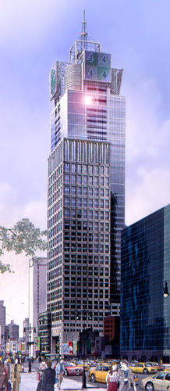
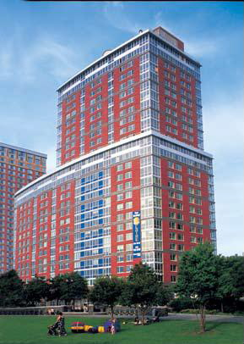
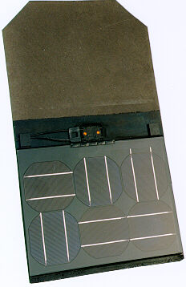
Building Integrated Solar Energy Systems
Creating Sustainability in Crystal City
  Crystal Plaza II Overview
  Consolidation of Slab Penetrations
  Building Integrated Solar Energy System
    Design considerations, technology, energy results
  Peak Demand Shift and Demand Response Programs
  Financing Projects through Energy Savings
  Conclusion and Questions
Products and Design
  BIPV
    Integrated into building component, such as curtain wall or shingles
    Typically thin film
      Cheaper
      Mass production
    3-5 W/sf production (WBDG)
Case Studies
  4 Times Square, NYC
  Solaire, NYC
Replaces spandrel panels
Located on upper floors
Produces 24/7
20kW system
Powers about 5 offices
Replaces spandrel panels
33kW system
Designed to provide 5%
Can power about 20 units

Slide 28
Building Integrated Solar Energy Systems
Creating Sustainability in Crystal City
  Crystal Plaza II Overview
  Consolidation of Slab Penetrations
  Building Integrated Solar Energy System
    Design considerations, technology, energy results
  Peak Demand Shift and Demand Response Programs
  Financing Projects through Energy Savings
  Conclusion and Questions
Products and Design
  Modeled after SeeThru system by SUNTECH
    Various, custom sizes
    Transparency 1-10%
    Can easily match non-BIPV glazing
    $8,500/installed kW
Case Studies
  4 Times Square, NYC
  Solaire, NYC
Replaces spandrel panels
33kW system
Designed to provide 5%
Can power about 20 units

Slide 29
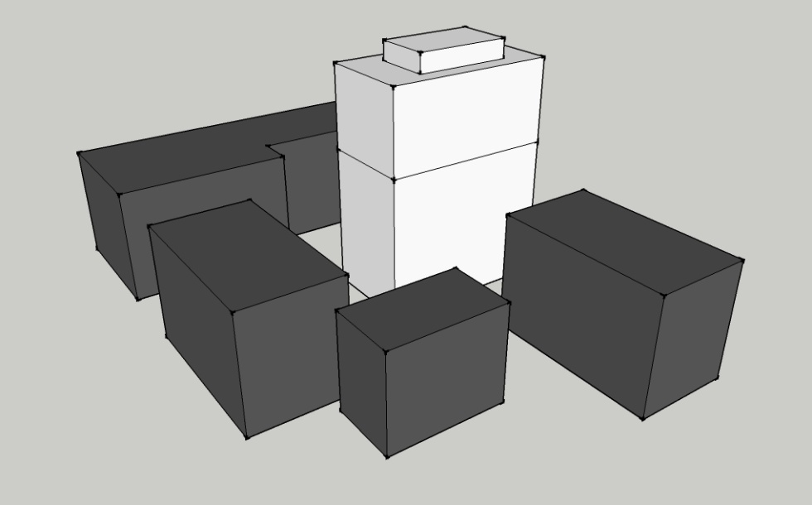
Building Integrated Solar Energy Systems
Creating Sustainability in Crystal City
  Crystal Plaza II Overview
  Consolidation of Slab Penetrations
  Building Integrated Solar Energy System
    Design considerations, technology, energy results
  Peak Demand Shift and Demand Response Programs
  Financing Projects through Energy Savings
  Conclusion and Questions
Products and Design
  Modeled after SeeThru system by SUNTECH
    Various, custom sizes
    Transparency 1-10%
    Can easily match non-BIPV glazing
    $8,500/installed kW
Shadow Study
  Uses Google SketchUp
  No shading above 12th floor from surroundings
  Even North façade receives sun

Slide 30
Building Integrated Solar Energy Systems
Creating Sustainability in Crystal City
  Crystal Plaza II Overview
  Consolidation of Slab Penetrations
  Building Integrated Solar Energy System
    Design considerations, technology, energy results
  Peak Demand Shift and Demand Response Programs
  Financing Projects through Energy Savings
  Conclusion and Questions
Production Analysis
  Dominion of Virginia Residential Schedule 1
  120/240V system demand of 1513 kW
  Adjusted demand in 908 kW
  Daily usage about 21,800 kWh
    About 80 kWh/unit
 | Month
 | Jan | Feb | Mar | Apr | May | Jun | Jul | Aug | Sep | Oct | Nov | Dec
Service Charge | $1,862 | $1,862 | $1,862 | $1,862 | $1,862 | $1,862 | $1,862 | $1,862 | $1,862 | $1,862 | $1,862 | $1,862
Dist Charge | $8,523 | $7,699 | $8,523 | $8,248 | $8,523 | $8,248 | $8,523 | $8,523 | $8,248 | $8,523 | $8,248 | $8,523
Supply Charge | $21,667 | $19,571 | $21,667 | $20,968 | $21,667 | $39,559 | $40,878 | $40,878 | $39,559 | $21,667 | $20,968 | $21,667
Total | $32,052 | $29,132 | $32,052 | $31,079 | $32,052 | $49,669 | $51,263 | $51,263 | $49,669 | $32,052 | $31,079 | $32,052
Total/ unit | $120 | $110 | $120 | $117 | $120 | $187 | $193 | $193 | $187 | $120 | $117 | $120

Slide 31
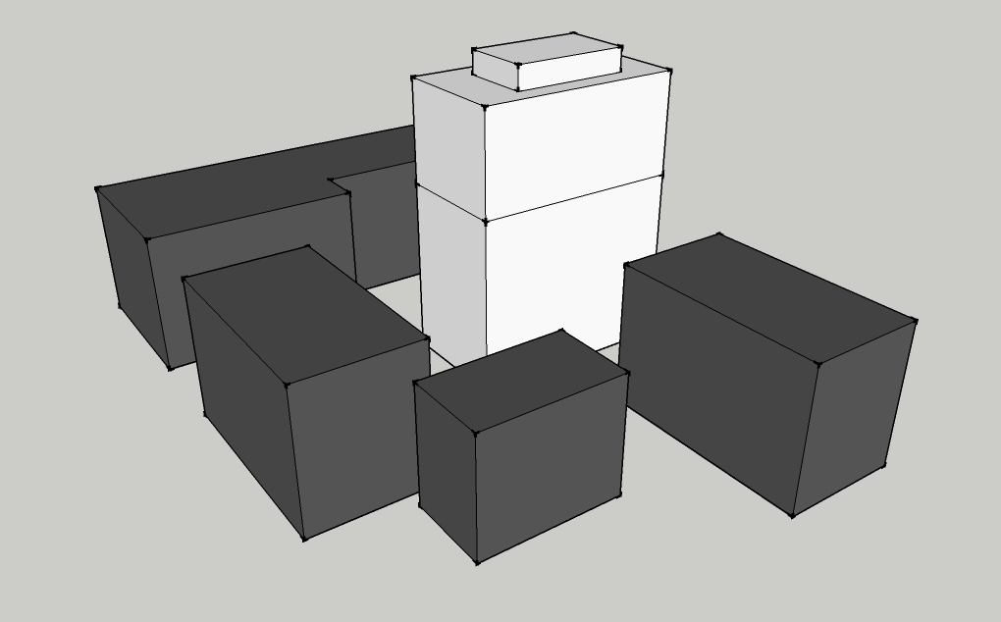
Building Integrated Solar Energy Systems
Location | Area (sq meters) | Area (sq feet) | Efficiency Material | Efficiency Orientation
South | 1,655.38 | 17,818.51 | 7.0% | 67.0%
Creating Sustainability in Crystal City
  Crystal Plaza II Overview
  Consolidation of Slab Penetrations
  Building Integrated Solar Energy System
    Design considerations, technology, energy results
  Peak Demand Shift and Demand Response Programs
  Financing Projects through Energy Savings
  Conclusion and Questions
South Façade Analysis
South Façade
 | Sun Hours(kWh/m2/day)
 | Jan | Feb | Mar | Apr | May | Jun | Jul | Aug | Sep | Oct | Nov | Dec | Yr Avg
 | 3.4 | 3.7 | 3.5 | 3.1 | 2.6 | 2.5 | 2.6 | 2.9 | 3.3 | 3.7 | 3.3 | 3 | 3.13
Days | 31 | 28 | 31 | 30 | 31 | 30 | 31 | 31 | 30 | 31 | 30 | 31 | 365
kWh/mon | 8182.97 | 8043.23 | 8423.65 | 7220.27 | 6257.57 | 5822.80 | 6257.57 | 6979.60 | 7686.09 | 8905.00 | 7686.09 | 7220.27 | 7390.43
Monthly kWh | 675,818.35 | 610,416.58 | 675,818.35 | 654,017.76 | 675,818.35 | 654,017.76 | 675,818.35 | 675,818.35 | 654,017.76 | 675,818.35 | 654,017.76 | 675,818.35
Monthly kWh after Solar | 667,635.38 | 602,373.35 | 667,394.70 | 646,797.49 | 669,560.78 | 648,194.96 | 669,560.78 | 668,838.76 | 646,331.67 | 666,913.35 | 646,331.67 | 668,598.08 | 7,868,530.97
Monthly Bill w/o solar | $32,052.02 | $29,131.83 | $32,052.02 | $31,078.62 | $32,052.02 | $49,669.20 | $51,263.04 | $51,263.04 | $49,669.20 | $32,052.02 | $31,078.62 | $32,052.02 | 453413.63
Bill/unit | $120.50 | $109.52 | $120.50 | $116.84 | $120.50 | $186.73 | $192.72 | $192.72 | $186.73 | $120.50 | $116.84 | $120.50
Monthly Bill w/solar | $31,686.65 | $28,772.70 | $31,675.90 | $30,756.24 | $31,772.62 | $49,243.49 | $50,805.55 | $50,752.76 | $49,107.27 | $31,654.41 | $30,735.44 | $31,729.63 | 448692.65
Bill/unit | $119.12 | $108.17 | $119.08 | $115.62 | $119.45 | $185.13 | $191.00 | $190.80 | $184.61 | $119.00 | $115.55 | $119.28
 |  |  |  |  |  |  |  |  |  |  |  |  | Total
Savings | $365.37 | $359.13 | $376.12 | $322.39 | $279.40 | $425.70 | $457.49 | $510.28 | $561.93 | $397.61 | $343.18 | $322.39 | $4,720.98

Slide 32
Building Integrated Solar Energy Systems
Location | Area (sq meters) | Area (sq feet) | Efficiency Material | Efficiency Orientation
South | 1,655.38 | 17,818.51 | 7.0% | 67.0%
Creating Sustainability in Crystal City
  Crystal Plaza II Overview
  Consolidation of Slab Penetrations
  Building Integrated Solar Energy System
    Design considerations, technology, energy results
  Peak Demand Shift and Demand Response Programs
  Financing Projects through Energy Savings
  Conclusion and Questions
South Façade Analysis
Size kW | Total kWh | Efficiency of Grid System | kWh/Year | Cost/kW Installed | Cost of System | Payback
89 | 88685.11 | 0.90 | 79,816 | $8,500.00 | $757,286 | 160.41
South Façade
 | Sun Hours(kWh/m2/day)
 | Jan | Feb | Mar | Apr | May | Jun | Jul | Aug | Sep | Oct | Nov | Dec | Yr Avg
 | 3.4 | 3.7 | 3.5 | 3.1 | 2.6 | 2.5 | 2.6 | 2.9 | 3.3 | 3.7 | 3.3 | 3 | 3.13
days | 31 | 28 | 31 | 30 | 31 | 30 | 31 | 31 | 30 | 31 | 30 | 31 | 365
kWh/mon | 8182.97 | 8043.23 | 8423.65 | 7220.27 | 6257.57 | 5822.80 | 6257.57 | 6979.60 | 7686.09 | 8905.00 | 7686.09 | 7220.27 | 7390.43
Monthly kWh | 675,818.35 | 610,416.58 | 675,818.35 | 654,017.76 | 675,818.35 | 654,017.76 | 675,818.35 | 675,818.35 | 654,017.76 | 675,818.35 | 654,017.76 | 675,818.35
Monthly kWh after Solar | 667,635.38 | 602,373.35 | 667,394.70 | 646,797.49 | 669,560.78 | 648,194.96 | 669,560.78 | 668,838.76 | 646,331.67 | 666,913.35 | 646,331.67 | 668,598.08 | 7,868,530.97
Monthly Bill w/o solar | $32,052.02 | $29,131.83 | $32,052.02 | $31,078.62 | $32,052.02 | $49,669.20 | $51,263.04 | $51,263.04 | $49,669.20 | $32,052.02 | $31,078.62 | $32,052.02 | 453413.63
Bill/unit | $120.50 | $109.52 | $120.50 | $116.84 | $120.50 | $186.73 | $192.72 | $192.72 | $186.73 | $120.50 | $116.84 | $120.50
Monthly Bill w/solar | $31,686.65 | $28,772.70 | $31,675.90 | $30,756.24 | $31,772.62 | $49,243.49 | $50,805.55 | $50,752.76 | $49,107.27 | $31,654.41 | $30,735.44 | $31,729.63 | 448692.65
Bill/unit | $119.12 | $108.17 | $119.08 | $115.62 | $119.45 | $185.13 | $191.00 | $190.80 | $184.61 | $119.00 | $115.55 | $119.28
 |  |  |  |  |  |  |  |  |  |  |  |  | Total
Savings | $365.37 | $359.13 | $376.12 | $322.39 | $279.40 | $425.70 | $457.49 | $510.28 | $561.93 | $397.61 | $343.18 | $322.39 | $4,720.98
Total yearly savings of $4,720
(79,800 kWh at $0.06/kWh)

Slide 33
Building Integrated Solar Energy Systems
Location | Area (sq meters) | Area (sq feet) | Efficiency Material | Efficiency Orientation
South | 1,655.38 | 17,818.51 | 7.0% | 67.0%
East | 927.92 | 9,988.08 | 7.0% | 53.0%
West | 927.92 | 9,988.08 | 7.0% | 53.0%
Creating Sustainability in Crystal City
  Crystal Plaza II Overview
  Consolidation of Slab Penetrations
  Building Integrated Solar Energy System
    Design considerations, technology, energy results
  Peak Demand Shift and Demand Response Programs
  Financing Projects through Energy Savings
  Conclusion and Questions
South, East, & West Façade Analysis
Size kW |  | Total kWh | Efficiency of Grid System | kWh/Year | Cost/kW Installed | Cost of System | Payback
89 | 88685.11 |  | 0.90 | 79,816 | $8,500.00 | $757,286
50 | 39324.42 |  | 0.90 | 35,391 | $8,500.00 | $424,493
50 | 39324.42 |  | 0.90 | 35,391 | $8,500.00 | $424,493
 |  |  |  |  | Total | $1,606,273 | 180.32
Total yearly savings of $9,000
(150,600 kWh at $0.06/kWh)

Slide 34
Building Integrated Solar Energy Systems
Location | Area (sq meters) | Area (sq feet) | Efficiency Material | Efficiency Orientation
South | 1,655.38 | 17,818.51 | 7.0% | 67.0%
East | 927.92 | 9,988.08 | 7.0% | 53.0%
West | 927.92 | 9,988.08 | 7.0% | 53.0%
North | 1,655.38 | 17,818.51 | 7.0% | 25.0%
Creating Sustainability in Crystal City
  Crystal Plaza II Overview
  Consolidation of Slab Penetrations
  Building Integrated Solar Energy System
    Design considerations, technology, energy results
  Peak Demand Shift and Demand Response Programs
  Financing Projects through Energy Savings
  Conclusion and Questions
All Façades Analysis
Size kW | Total kWh | Efficiency of Grid System | kWh/Year | Cost/kW Installed | Cost of System | Payback
89 | 88685.11 | 0.90 | 79,816 | $8,500.00 | $757,286
50 | 39324.42 | 0.90 | 35,391 | $8,500.00 | $424,493
50 | 39324.42 | 0.90 | 35,391 | $8,500.00 | $424,493
89 | 25,317.53 | 0.90 | 22,785 | $8,500.00 | $757,286
 |  |  |  | Total | $2,363,559 | 223.39
Total yearly savings of $10,380
(173,000 kWh at $0.06/kWh)

Slide 35
Building Integrated Solar Energy Systems
Creating Sustainability in Crystal City
  Crystal Plaza II Overview
  Consolidation of Slab Penetrations
  Building Integrated Solar Energy System
    Design considerations, technology, energy results
  Peak Demand Shift and Demand Response Programs
  Financing Projects through Energy Savings
  Conclusion and Questions
All Façades Analysis
Size kW | Total kWh | Efficiency of Grid System | kWh/Year | Cost/kW Installed | Cost of System | Payback
89 | 88685.11 | 0.90 | 79,816 | $8,500.00 | $757,286
50 | 39324.42 | 0.90 | 35,391 | $8,500.00 | $424,493
50 | 39324.42 | 0.90 | 35,391 | $8,500.00 | $424,493
89 | 25,317.53 | 0.90 | 22,785 | $8,500.00 | $757,286
 |  |  |  | Total | $2,363,559 | 223.39
Total yearly savings of $10,380
(173,000 kWh at $0.06/kWh)

Slide 36
Building Integrated Solar Energy Systems
Creating Sustainability in Crystal City
  Crystal Plaza II Overview
  Consolidation of Slab Penetrations
  Building Integrated Solar Energy System
    Design considerations, technology, energy results
  Peak Demand Shift and Demand Response Programs
  Financing Projects through Energy Savings
  Conclusion and Questions
Inverter
  Panel
    40 sf, produces about 200 W
    60 V_{oc}
    South façade, single floor
      1,320 V_{oc} (60 V_{oc} x 22 panels)
  Inverter
    Xantrex GT5.0
    Max V_{oc} of 600 V
    Need 3 inverters per floor
    27 overall for south façade
Wire
  NEC
  Panel to Inverter
    AWG 14
  Inverter to Controller
    AWG 10
  Controller to Electrical Panel
    AWG 3
Inverter | Short Circuit Amp PV | # of Panels in Series | Total Amp
1 | 1.14 | 7 | 7.98
2 | 1.14 | 7 | 7.98
3 | 1.14 | 8 | 9.12

Slide 37
Building Integrated Solar Energy Systems
Creating Sustainability in Crystal City
  Crystal Plaza II Overview
  Consolidation of Slab Penetrations
  Building Integrated Solar Energy System
    Design considerations, technology, energy results
  Peak Demand Shift and Demand Response Programs
  Financing Projects through Energy Savings
  Conclusion and Questions
Summary
  Generating capabilities
  Best scenario is South, East, and West facades
  Large capital cost
  Long payback
  Not feasible without rebates, incentives, and tax credits

Slide 38
Peak Demand Shift and Demand Response
Creating Sustainability in Crystal City
  Crystal Plaza II Overview
  Consolidation of Slab Penetrations
  Building Integrated Solar Energy System
  Peak Demand Shift and Demand Response Programs
    Background, local programs, generator use, results
  Financing Projects through Energy Savings
  Conclusion and Questions
Background
  Rising energy cost
  Efficient systems
  Utilization of generation equipment
Problem
  Energy peaks, costly
  Better use of generation equipment
Goal
  Identify local programs for demand response
  Evaluate use of generator to shave demand

Slide 39
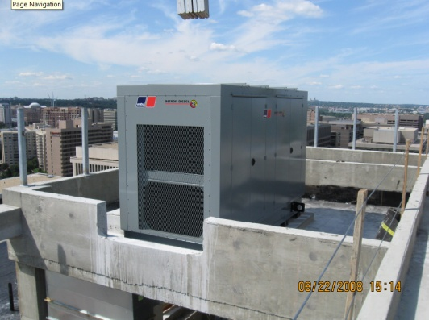
Peak Demand Shift and Demand Response
 |  | Fuel Use (gal/hr) |  |  | Cost/hr |  | Runtime till empty (hr)
Power | kW | Standby | Prime | Fuel Cost/gal* | Standby | Prime | Standby | Prime
100% | 450 | 35 | 32 | 3.76 | $130.10 | $121.45 | 16.24 | 17.40
75% | 337.5 | 26 | 24 | 3.76 | $99.26 | $91.37 | 21.29 | 23.13
50% | 225 | 18 | 16 | 3.76 | $68.43 | $61.66 | 30.88 | 34.27
25% | 112.5 | 9 | 8 | 3.76 | $34.22 | $30.83 | 61.76 | 68.54
*average from Jan 08-Jan 09
Creating Sustainability in Crystal City
  Crystal Plaza II Overview
  Consolidation of Slab Penetrations
  Building Integrated Solar Energy System
  Peak Demand Shift and Demand Response Programs
    Background, local programs, generator use, results
  Financing Projects through Energy Savings
  Conclusion and Questions
Peak Demand Shift
  Use 450 kW emergency generator
  More interaction from owner with utility
  Use installed equipment, avoid additional costs
  Use during peak times, 6-9 am and 4-7 pm
    Heavy elevator and mechanical use

Slide 40
Peak Demand Shift and Demand Response
 |  | Fuel Use (gal/hr) |  |  | Cost/hr |  | Runtime till empty (hr)
Power | kW | Standby | Prime | Fuel Cost/gal* | Standby | Prime | Standby | Prime
100% | 450 | 35 | 32 | 3.76 | $130.10 | $121.45 | 16.24 | 17.40
75% | 337.5 | 26 | 24 | 3.76 | $99.26 | $91.37 | 21.29 | 23.13
50% | 225 | 18 | 16 | 3.76 | $68.43 | $61.66 | 30.88 | 34.27
25% | 112.5 | 9 | 8 | 3.76 | $34.22 | $30.83 | 61.76 | 68.54
*average from Jan 08-Jan 09
Creating Sustainability in Crystal City
  Crystal Plaza II Overview
  Consolidation of Slab Penetrations
  Building Integrated Solar Energy System
  Peak Demand Shift and Demand Response Programs
    Background, local programs, generator use, results
  Financing Projects through Energy Savings
  Conclusion and Questions
Equipment Name | Type | Service | Phase | V | A | HP | kW | % used/hr | hours used | kW/hr | kWh
P-5 | vertical inline pump | HP Loop | 3 | 480 | 155.00 | 125 | 103.09 | 100% | 5 | 103.09 | 515.46
RTU-1 | RTU |  | 3 | 480 | 71.40 |  | 47.49 | 60% | 5 | 28.49 | 142.47
RTU-2 | RTU |  | 3 | 480 | 71.40 |  | 47.49 | 60% | 5 | 28.49 | 142.47
RTU-3 | RTU |  | 3 | 480 | 71.40 |  | 47.49 | 60% | 5 | 28.49 | 142.47
RTU-4 | RTU |  | 3 | 480 | 71.40 |  | 47.49 | 60% | 5 | 28.49 | 142.47
CT-1 | cooling tower fan | cooling tower | 3 | 480 | 56.07 | 50 | 37.29 | 50% | 5 | 18.65 | 93.23
CT-2 | cooling tower fan | cooling tower | 3 | 480 | 56.07 | 50 | 37.29 | 50% | 5 | 18.65 | 93.23
P-3 | Double Suction | cooling tower | 3 | 480 | 52.00 | 40 | 34.59 | 50% | 5 | 17.29 | 86.46
P-1 | vertical inline pump | cooling tower | 3 | 480 | 40.00 | 30 | 26.60 | 50% | 5 | 13.30 | 66.51
Elevator 1 |  |  | 3 | 480 | 29.00 | 26 | 19.29 | 90% | 5 | 17.36 | 86.80
Elevator 2 |  |  | 3 | 480 | 29.00 | 26 | 19.29 | 90% | 5 | 17.36 | 86.80
Elevator 3 |  |  | 3 | 480 | 29.00 | 26 | 19.29 | 90% | 5 | 17.36 | 86.80
RTU-5 | RTU |  | 3 | 480 | 17.60 |  | 11.71 | 60% | 5 | 7.02 | 35.12

Slide 41
Peak Demand Shift and Demand Response
Distribution Service Charge
cost per kw | kw | cost
1 | 1830 | $1,830.00
Basic Customer Charge |  | $127.60
Supply Service Charges
On Peak Supply Demand Charge
cost per kw | kw | cost
12.003 | 1098 | $13,179.29
11.715 | 1098 | $12,863.07
Off Peak Supply Demand Charges
0.632 | 1098 | $693.94
Supply Adjustment Demand Charge
0.421 | 1830 | $770.43
On peak kWh
0.404 | 428220 | $173,000.88
Off peak kWh
0.272 | 362340 | $98,556.48
Total |  | $301,021.69
 |  | Fuel Use (gal/hr) |  |  | Cost/hr |  | Runtime till empty (hr)
Power | kW | Standby | Prime | Fuel Cost/gal* | Standby | Prime | Standby | Prime
100% | 450 | 35 | 32 | 3.76 | $130.10 | $121.45 | 16.24 | 17.40
75% | 337.5 | 26 | 24 | 3.76 | $99.26 | $91.37 | 21.29 | 23.13
50% | 225 | 18 | 16 | 3.76 | $68.43 | $61.66 | 30.88 | 34.27
25% | 112.5 | 9 | 8 | 3.76 | $34.22 | $30.83 | 61.76 | 68.54
*average from Jan 08-Jan 09
Creating Sustainability in Crystal City
  Crystal Plaza II Overview
  Consolidation of Slab Penetrations
  Building Integrated Solar Energy System
  Peak Demand Shift and Demand Response Programs
    Background, local programs, generator use, results
  Financing Projects through Energy Savings
  Conclusion and Questions

Slide 42
Peak Demand Shift and Demand Response
Distribution Service Charge
cost per kw | kw | cost
1 | 1830 | $1,830.00
Basic Customer Charge |  | $127.60
Supply Service Charges
On Peak Supply Demand Charge
cost per kw | kw | cost
12.003 | 1098 | $13,179.29
11.715 | 1098 | $12,863.07
Off Peak Supply Demand Charges
0.632 | 1098 | $693.94
Supply Adjustment Demand Charge
0.421 | 1830 | $770.43
On peak kWh
0.404 | 428220 | $173,000.88
Off peak kWh
0.272 | 362340 | $98,556.48
Total |  | $301,021.69
Distribution Service Charge
cost per kw | kw | cost
1 | 1430 | $1,430.00
Basic Customer Charge |  | $127.60
Supply Service Charges
On Peak Supply Demand Charge
cost per kw | kw | cost
12.003 | 698 | $8,378.09
11.715 | 698 | $8,177.07
Off Peak Supply Demand Charges
0.632 | 858 | $542.26
Supply Adjustment Demand Charge
0.421 | 1430 | $602.03
On peak kWh
0.404 | 371865.56 | $150,233.69
Off peak kWh
0.272 | 362340.00 | $98,556.48
Total |  | $268,047.22
Difference
$400.00
$4,801.20
$4,686.00
$151.68
$168.40
$22,767.19
$32,974.47
Total |  | $32,974.47
 | Fuel Cost | $17,295.00
 | Savings | $15,679.47
Creating Sustainability in Crystal City
  Crystal Plaza II Overview
  Consolidation of Slab Penetrations
  Building Integrated Solar Energy System
  Peak Demand Shift and Demand Response Programs
    Background, local programs, generator use, results
  Financing Projects through Energy Savings
  Conclusion and Questions

Slide 43
Peak Demand Shift and Demand Response
Creating Sustainability in Crystal City
  Crystal Plaza II Overview
  Consolidation of Slab Penetrations
  Building Integrated Solar Energy System
  Peak Demand Shift and Demand Response Programs
    Background, local programs, generator use, results
  Financing Projects through Energy Savings
  Conclusion and Questions
Summary
  Suggest demand response due to net metering issues
  Evaluate on small scale, mandatory vs. volunteer
  Saving on demand creates large savings
  Not most sustainable way to curtail loads

Slide 44
Financing Projects through Energy Savings
Creating Sustainability in Crystal City
  Crystal Plaza II Overview
  Consolidation of Slab Penetrations
  Building Integrated Solar Energy System
  Peak Demand Shift and Demand Response Programs
  Financing Projects through Energy Savings
    Goals, incentives/rebates
  Conclusion and Questions
Background
  Financing projects is hard, especially in today’s economy
  Use savings to help finance
    Performance contractors
    Guaranteed savings
    Unique marketing approach to owner?
  Rebates, Incentives, and Tax Credits
  Critical Issue
Problem Statement
  Availability of programs to assist in sustainable and energy saving endeavors
  Move towards renovations for facility savings
Goal
  Evaluate programs for application to Crystal Plaza II, especially in the areas of previous analyses, and show how these systems can create a unique marketing tool to assist in financing.

Slide 45
Financing Projects through Energy Savings
Creating Sustainability in Crystal City
  Crystal Plaza II Overview
  Consolidation of Slab Penetrations
  Building Integrated Solar Energy System
  Peak Demand Shift and Demand Response Programs
  Financing Projects through Energy Savings
    Goals, incentives/rebates
  Conclusion and Questions
Programs
  Arlington County Green Building Incentive Program
    Based on USGBC’s LEED ratings
    Grants density and height bonuses
      0.15 increase for Certified
      0.25 increase for Silver
      0.35 increase for Gold/Platinum
    Green Building Fund created for education of developers
      $0.03/sf mandatory contribution for non-LEED buildings
    Application at Crystal Plaza II
      Saves $9,750 from contribution, no effect of FAR
  TVA Green Power Switch Generation Partners
    Limited to TVA service area
    Green energy produced by participant is bought by TVA and used in their green pricing program for customers
    $0.20/kWh compensation on 10 year contract
    Application at Crystal Plaza II
      Not applicable, outside service area
      Suggest program to local utility and negotiate rate/contract

Slide 46
Financing Projects through Energy Savings
Creating Sustainability in Crystal City
  Crystal Plaza II Overview
  Consolidation of Slab Penetrations
  Building Integrated Solar Energy System
  Peak Demand Shift and Demand Response Programs
  Financing Projects through Energy Savings
    Goals, incentives/rebates
  Conclusion and Questions
Application
  South Façade BIPV- $757,286
  Modified Accelerated Cost Recovery System (MARCS)
    Allows for solar to depreciate over 5 years
    Bonus of 50% depreciation as part of Economic Stimulus Act in Feb 2008
  Business Energy Investment Tax Credit (ITC)
    Tax credit for 30% of solar, with no limit

Slide 47
Financing Projects through Energy Savings
Creating Sustainability in Crystal City
  Crystal Plaza II Overview
  Consolidation of Slab Penetrations
  Building Integrated Solar Energy System
  Peak Demand Shift and Demand Response Programs
  Financing Projects through Energy Savings
    Goals, incentives/rebates
  Conclusion and Questions
Application
  South Façade BIPV- $757,286
    Payback period using only energy savings is 4.72 years

Slide 48
Financing Projects through Energy Savings
Creating Sustainability in Crystal City
  Crystal Plaza II Overview
  Consolidation of Slab Penetrations
  Building Integrated Solar Energy System
  Peak Demand Shift and Demand Response Programs
  Financing Projects through Energy Savings
    Goals, incentives/rebates
  Conclusion and Questions
Application
  Crystal Plaza II, $70,000,000 on 20 year loan at 6.5%
    $6,352,950/year or $529,412/month
  Use energy savings to help finance
    Demand response- $8,000
    Net metering “green” power- $16,000 (assuming TVA program)
    Demand shave- $180,000
    Total- $204,000
  Now, $6,148,950/year or $512,413 (basic analysis)
    PW analysis shows savings of $3,035,000 over life of loan at 3% inflation rate
    Saves 4.34% on loan

Slide 49
Financing Projects through Energy Savings
Creating Sustainability in Crystal City
  Crystal Plaza II Overview
  Consolidation of Slab Penetrations
  Building Integrated Solar Energy System
  Peak Demand Shift and Demand Response Programs
  Financing Projects through Energy Savings
    Goals, incentives/rebates
  Conclusion and Questions
Summary
  Using incentives, rebates, and tax credits BIPV becomes feasible
  Basic analysis shows a savings of about 4% on loan
    Market strategy to owner?
    Higher returns with efficient systems or more programs
  Owner had interest in “bundled” packages that included rebates, incentives, and credits that could help bottom line and use green/sustainable measures
  Crystal Plaza II, $70,000,000 on 20 year loan at 6.5%
    $6,352,950/year or $529,412/month
  Use energy savings to help finance
    Demand response- $8,000
    Net metering “green” power- $16,000 (assuming TVA program)
    Demand shave- $180,000
    Total- $204,000
  Now, $6,148,950/year or $512,413 (basic analysis)
    PW analysis shows savings of $3,035,000 over life of loan at 3% inflation rate
    Saves 4.34% on loan

Slide 50
Conclusions and Questions
Creating Sustainability in Crystal City
  Crystal Plaza II Overview
  Consolidation of Slab Penetrations
  Building Integrated Solar Energy System
  Peak Demand Shift and Demand Response Programs
  Financing Projects through Energy Savings
  Conclusion and Questions
Summary
  Consolidation of Slab Penetrations
    Use structural analysis tool to locate problematic and marginal areas
    Savings in rework of $55,000, and over $3,000 in material
  Building Integrated Solar Energy System
    Best case scenario is South, East, and West facades
    Feasible with rebates, incentives, and tax credits
  Peak Demand Shift and Demand Response
    Demand response better program to start with
    Peak demand shift has higher return, but is not as sustainable
Acknowledgements
Balfour Beatty Construction
Will Siegel
TJ Sawner
Sean Graham
Keith Dugan
John Garvey
Erica Lazzaro
Dave Laib
Steve Tapparo
Vornado/Charles E. Smith
Michael Harrington
Richard Smith
Questions?
Others
Greg Lok, CLT
Arif Mahmood, TCE
Tim Tarr, GHT
Andy Lau, Penn State University
Dr. David Riley, Penn State University
PACE Industry Members
Joseph Wilcher
Marissa Gesell

Slide 52
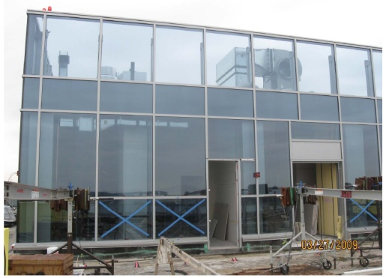
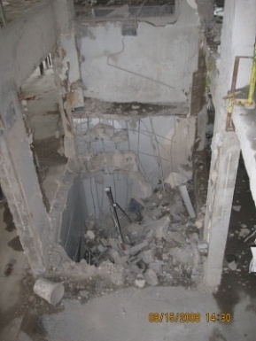
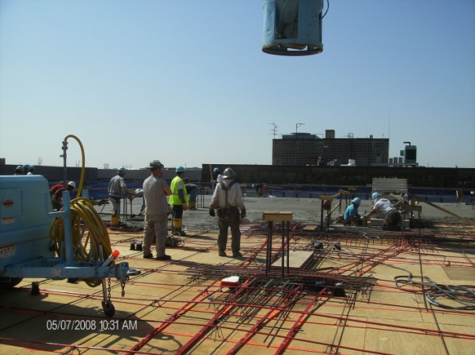

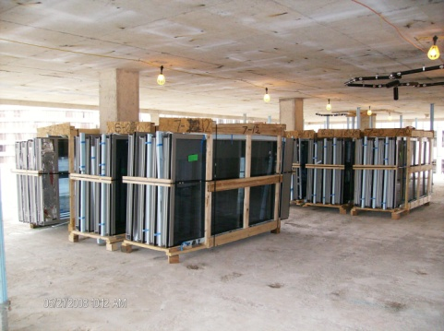
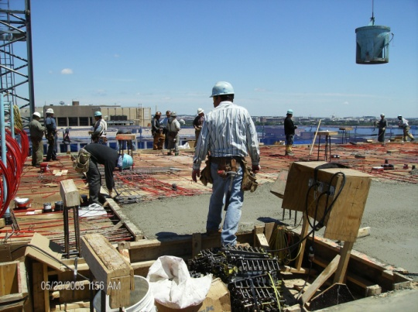
Crystal Plaza II Overview
Mechanical
4 RTU for fresh air
Individual Water source heat pumps
(2) 400 t cooling towers
(4) Natural gas fired boilers
Creating Sustainability in Crystal City
  Crystal Plaza II Overview
    Project background, challenges, site, and team
  Consolidation of Slab Penetrations
  Building Integrated Solar Energy System
  Peak Demand Shift and Demand Response Programs
  Financing Projects through Energy Savings
  Conclusion and Questions
Project Details
Electrical
19 meter centers
Bus duct
1514 kW demand 120/208V
1831 kW demand 277/480V
Curtain Wall
Unitized
Low-e glass
Large risk
Demolition
Exterior
Interior
Asbestos
Elevators/Stairs
Cast in Place Concrete
Post tensioned
Crane and Bucket
200 CY/pour, ~5 day floor cycle
Two mixes

Slide 53
Crystal Plaza II Overview
Owner/Delivery System
Constructability Challenges
Renovation
Required Delivery
Reconfiguration
Residential Curtain Wall
Creating Sustainability in Crystal City
  Crystal Plaza II Overview
    Project background, challenges, site, and team
  Consolidation of Slab Penetrations
  Building Integrated Solar Energy System
  Peak Demand Shift and Demand Response Programs
  Financing Projects through Energy Savings
  Conclusion and Questions
OWNER
Vornado/Charles E. Smith
Michael Harrington
GENERAL CONTRACTOR
Balfour Beatty Construction
Dave Laib and Bob Frew
ARCHITECT
Dorsky Hodgson Parrish Yue
Anthony Hill
Negoiated GMP
$67 million for construction
Preconstruction Services
Balfour Beatty as GC
LEED CONSULTANT
Greenshape
Holly Carr
STRUCTURAL ENGINEER
Tadjer Cohen Edelson
Arif Mahmood
CIVIL ENGINEER
VIKA Incorporated
Frank Jenkins
MEP ENGINEER
GHT Limited
Tim Tarr
PRIMARY SUBCONTRACTOR
Miller & Long Concrete
Concrete
PRIMARY SUBCONTRACTOR
Tyler Mechanical
Mechanical, Plumbing
PRIMARY SUBCONTRACTOR
Concrete Technology Service
Demolition
PRIMARY SUBCONTRACTOR
Truland Systems
Electrical

Slide 54
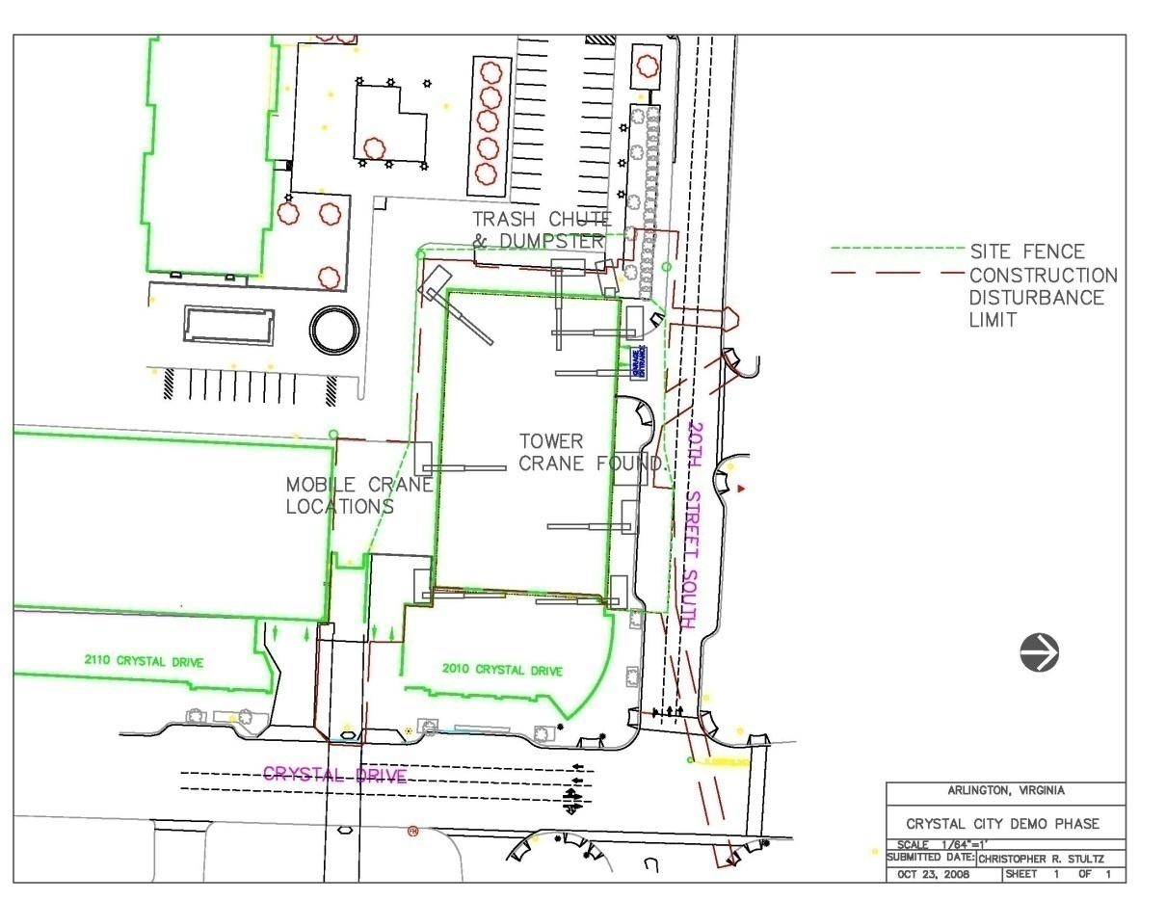
Creating Sustainability in Crystal City
  Crystal Plaza II Overview
    Project background, challenges, site, and team
  Consolidation of Slab Penetrations
  Building Integrated Solar Energy System
  Peak Demand Shift and Demand Response Programs
  Financing Projects through Energy Savings
  Conclusion and Questions

Slide 55
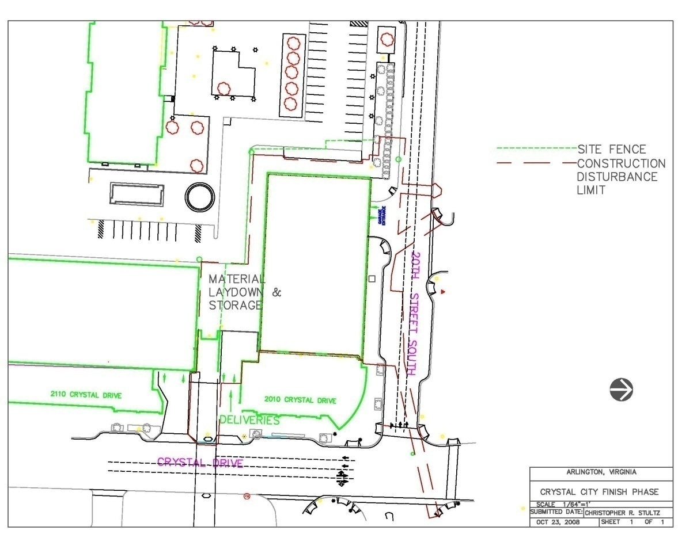
Creating Sustainability in Crystal City
  Crystal Plaza II Overview
    Project background, challenges, site, and team
  Consolidation of Slab Penetrations
  Building Integrated Solar Energy System
  Peak Demand Shift and Demand Response Programs
  Financing Projects through Energy Savings
  Conclusion and Questions

Slide 56
Cost
The following is a breakdown of specific building systems in the Crystal Plaza II project. Each category is representative of a specification division and other items from varying divisions have been included as noted.
  Mechanical System Cost: $13 Million
  Mechanical System Cost/SF: $40/SF
  Electrical System Cost: $7.5 Million
  Electrical System Cost/SF: $23.08/SF
  Structural System Cost (Concrete only): $4.1 Million
  Structural System Cost/SF: $12.62/SF
  Curtain Wall System (As part of Doors/Windows): $11.2 Million
  Curtain Wall System Cost/SF: $34.46/SF
General Conditions
  Grand Total $3,095,115.25

Slide 57
Dominion of Virginia does offer net metering,
  Limited/restricted
  Terms and Conditions for net metering, it is available to “customer-generator” using a “renewable energy facility” for the first 0.2% of Company’s North Carolina jurisdictional peak load during the previous year.
Alternating current capacity of no more than 100 kW for nonresidential customers
Its total fuel source is solar PV, wind power, micro-hydro, or biomass
Is for the customer-generator’s use and not for sale to a third party
Is interconnected and operated in parallel with the electric distribution system provided by the company (Virginia Electric and Power Company, 2006)

Slide 58
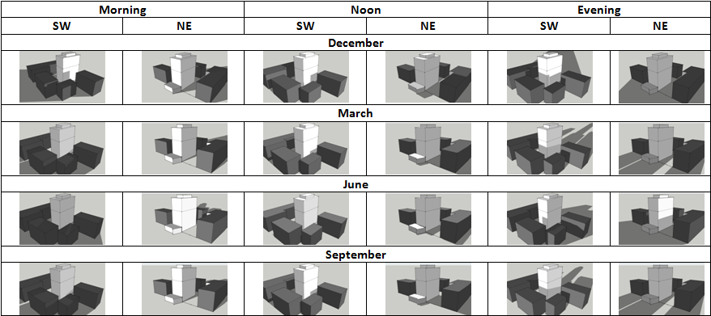
Building Integrated Solar Energy Systems
Creating Sustainability in Crystal City
  Crystal Plaza II Overview
  Consolidation of Slab Penetrations
  Building Integrated Solar Energy System
    Design considerations, technology, energy results
  Peak Demand Shift and Demand Response Programs
  Financing Projects through Energy Savings
  Conclusion and Questions
Shadow Study
  Uses Google SketchUp
  No shading above 12th floor from surroundings
  Even North façade receives sun

Slide 59
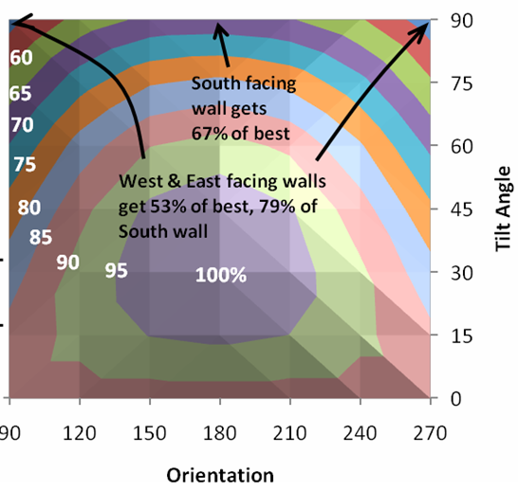
Building Integrated Solar Energy Systems
Creating Sustainability in Crystal City
  Crystal Plaza II Overview
  Consolidation of Slab Penetrations
  Building Integrated Solar Energy System
    Design considerations, technology, energy results
  Peak Demand Shift and Demand Response Programs
  Financing Projects through Energy Savings
  Conclusion and Questions
Equations
  E_{sol} = I_{t} A η t e
  where:
  I_{t} = long-term average solar per day per unit area at specific tilt and orientation from insolation table (W/m²-day)
  A = total area receiving sun
  η = annual efficiency of converting sunlight to useful energy
  t = time
  e= orientation efficiency

Slide 60
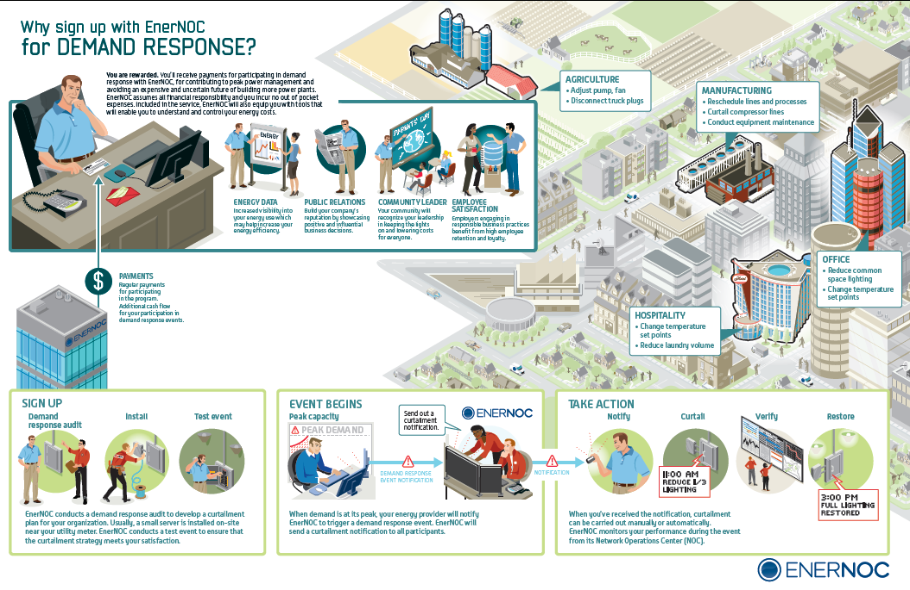
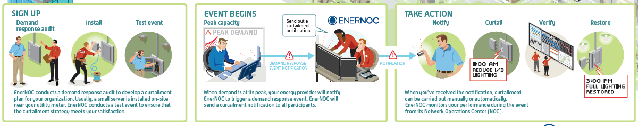
Peak Demand Shift and Demand Response
Creating Sustainability in Crystal City
  Crystal Plaza II Overview
  Consolidation of Slab Penetrations
  Building Integrated Solar Energy System
  Peak Demand Shift and Demand Response Programs
    Background, local programs, generator use, results
  Financing Projects through Energy Savings
  Conclusion and Questions
Demand Response

Slide 61
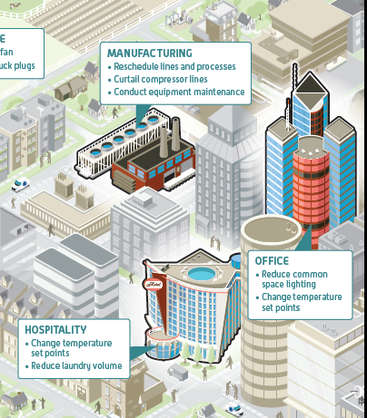
Peak Demand Shift and Demand Response
Creating Sustainability in Crystal City
  Crystal Plaza II Overview
  Consolidation of Slab Penetrations
  Building Integrated Solar Energy System
  Peak Demand Shift and Demand Response Programs
    Background, local programs, generator use, results
  Financing Projects through Energy Savings
  Conclusion and Questions
Demand Response

Slide 62
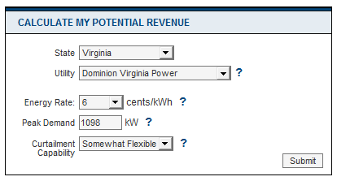
Peak Demand Shift and Demand Response
Creating Sustainability in Crystal City
  Crystal Plaza II Overview
  Consolidation of Slab Penetrations
  Building Integrated Solar Energy System
  Peak Demand Shift and Demand Response Programs
    Background, local programs, generator use, results
  Financing Projects through Energy Savings
  Conclusion and Questions
Demand Response
  EnergyConnect
    EventConnect
      Reservation Fee
      Compensation for curtailed energy
    FlexConnect
      Paid wholesale price according to PJM
      Fee removed by EnergyConnect for service
Potential Revenue
$8,138

Slide 63
Financing Projects through Energy Savings
Creating Sustainability in Crystal City
  Crystal Plaza II Overview
  Consolidation of Slab Penetrations
  Building Integrated Solar Energy System
  Peak Demand Shift and Demand Response Programs
  Financing Projects through Energy Savings
    Goals, incentives/rebates
  Conclusion and Questions
Programs
  Local Property Tax Assessment for Energy Efficient Buildings
    Comprehensive, whole building program
    Evaluates property tax at reduced rate
    Must exceed the energy efficiency standards of VA Uniform Building Code by 20%, or meet standards in Green Globes, LEED, or the EarthCraft program
  Application at Crystal Plaza II
    Qualifies for program if offered by Arlington County
    No response from program without tax information, withheld by owner
  Modified Accelerated Cost Recovery System (MARCS)
    Allows for solar to depreciate over 5 years
    Bonus of 50% depreciation as part of Economic Stimulus Act in Feb 2008
  Business Energy Investment Tax Credit (ITC)
    Tax credit for 30% of solar, with no limit
  U.S. Department of Treasury renewable Energy Grants
    Alternative to ITC, allowing for 30% of basis property for solar with no limit

